Slide 1
Roland Barthes –
The Death of the Author
22-05-2023
Ted van Aanholt MA
Philosophical Reflections – History of Thought

Slide 2
Roland Barthes – a short biography
12 November 1915: born in Cherbourg, Normandy
1935-1939: studies Classical Literature at Sorbonne
1939-1948: struggles with health, further education in Grammar and Philology, influenced by Marx, Sartre and Michelet
1952: Researcher at CNRS in Lexicology and Sociology and starts publishing his Mythologies (1957)
1960’s: More acclaim, focus on structuralism and literature
1967: The Death of the Author
1977: Mother dies, publishes Camera Lucida
25 February 1980: Dies from chest injuries sustained after a crash with a laundry van

Slide 3
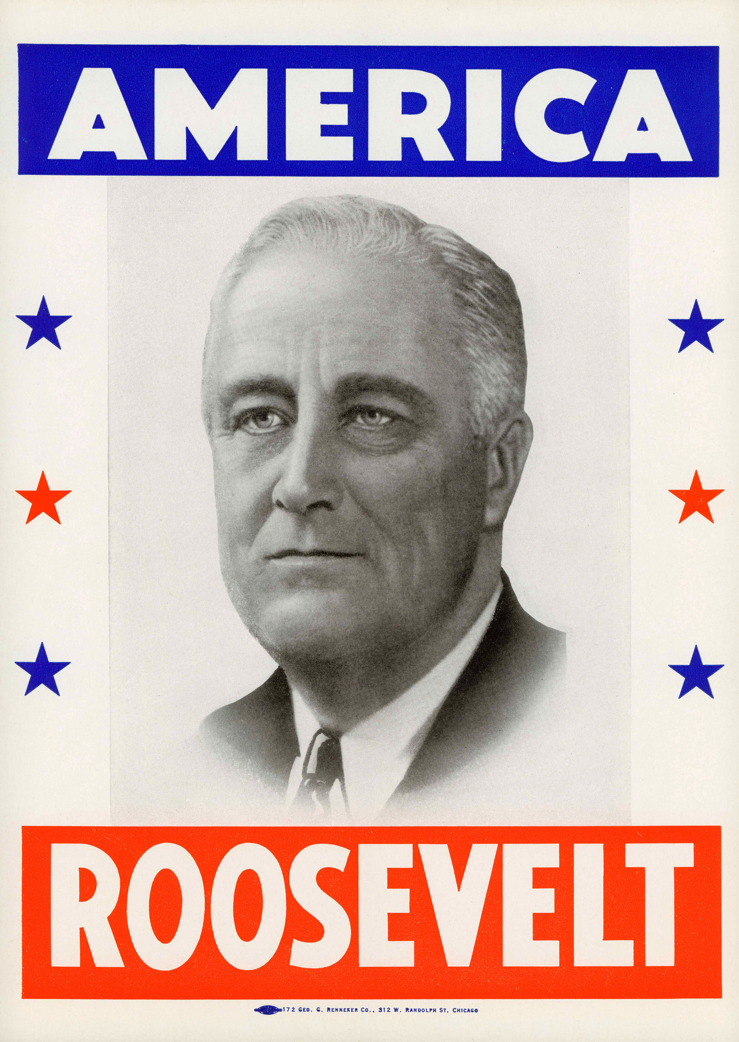



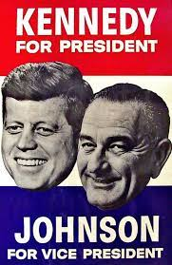

Mythologies

Slide 4


Slide 5
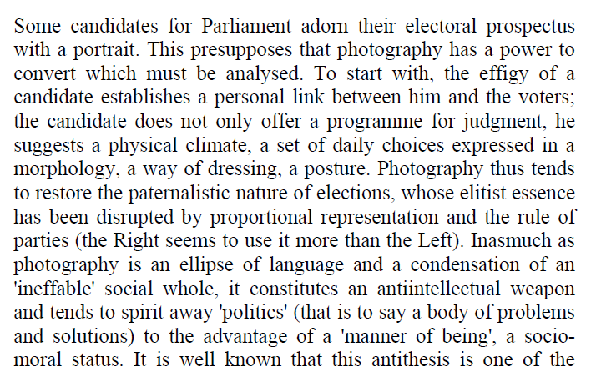

Photography and Electoral Appeal

Slide 6
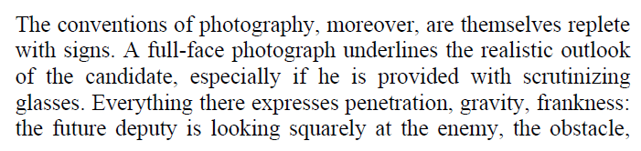
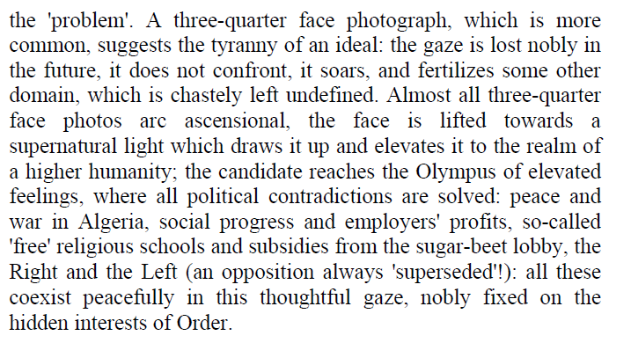
Photography and Electoral Appeal

Slide 7
Mythologies
Semiotics > the study of signs
  The “language-object”
  The “metalanguage”
Cowboy hat, red white blue, smile, blue jacket (first order signs)
True American; father figure; Christian; hard, physical work; vigor; (second order signs / connotations)
Metalanguage constructs the myth
Consumer culture, political status quo, capitalism
Myths are culturally and historically determined, but presented as obvious and natural
Myths are structures: structuralism

Slide 8
The death of the author
Photographer: I did not intend to portray Reagan as a father figure and a Christian
Barthes: “structuralist reading”

Slide 9
Questions
Explain what Barthes means when he writes that "writing is the destruction of every voice, of every point of origin".
Explain why 'the Author' is a product of modern society according to Barthes.
According to Barthes, the Author should let language speak through a 'prerequisite impersonality' rather than the 'castrating objectivity of the realist novelist'. Explain the difference between these two ways of writing.
The Author is succeeded by the scriptor. Explain the difference between the two.
What is the role of the Critic in the creation of the Author? Explain.
Barthes argues that the death of the Author changes the way we read a text. Explain how this happens.
If the Author indeed has died, what are the implications for how we look at authorship today? Give some examples.

Slide 10
Art Criticism: Anti-intentionalism
Warburton
Only look at the work itself
All secondary sources are irrelevant
Critical interpretation
Intentional fallacy:
  Relying on external rather than internal evidence when interpreting a work of art
Roland Barthes (1915 – 1980):
  Death of the Author
  More next week
Critique:
Mistaken view of intention
  Not separate mental events, but combined with action
  Not a satisfactory critique: action is also external
Irony
  To appreciate certain parts of art (like irony) external knowledge is (sometimes) necessary
Too narrow a view of art criticism
  External evidence is also part of art criticism

